Slide 1
Cloud Computing Architecture

Slide 2
Contents
Introduction
Cloud Reference Model
Types of Clouds
Economics of the Cloud
Open Challenges

Slide 3
Introduction
This chapter addresses the following questions:
What makes cloud computing so interesting to IT Stakeholders and research practitioners?
How does it introduces innovation into the field of distributed computing?

Slide 4
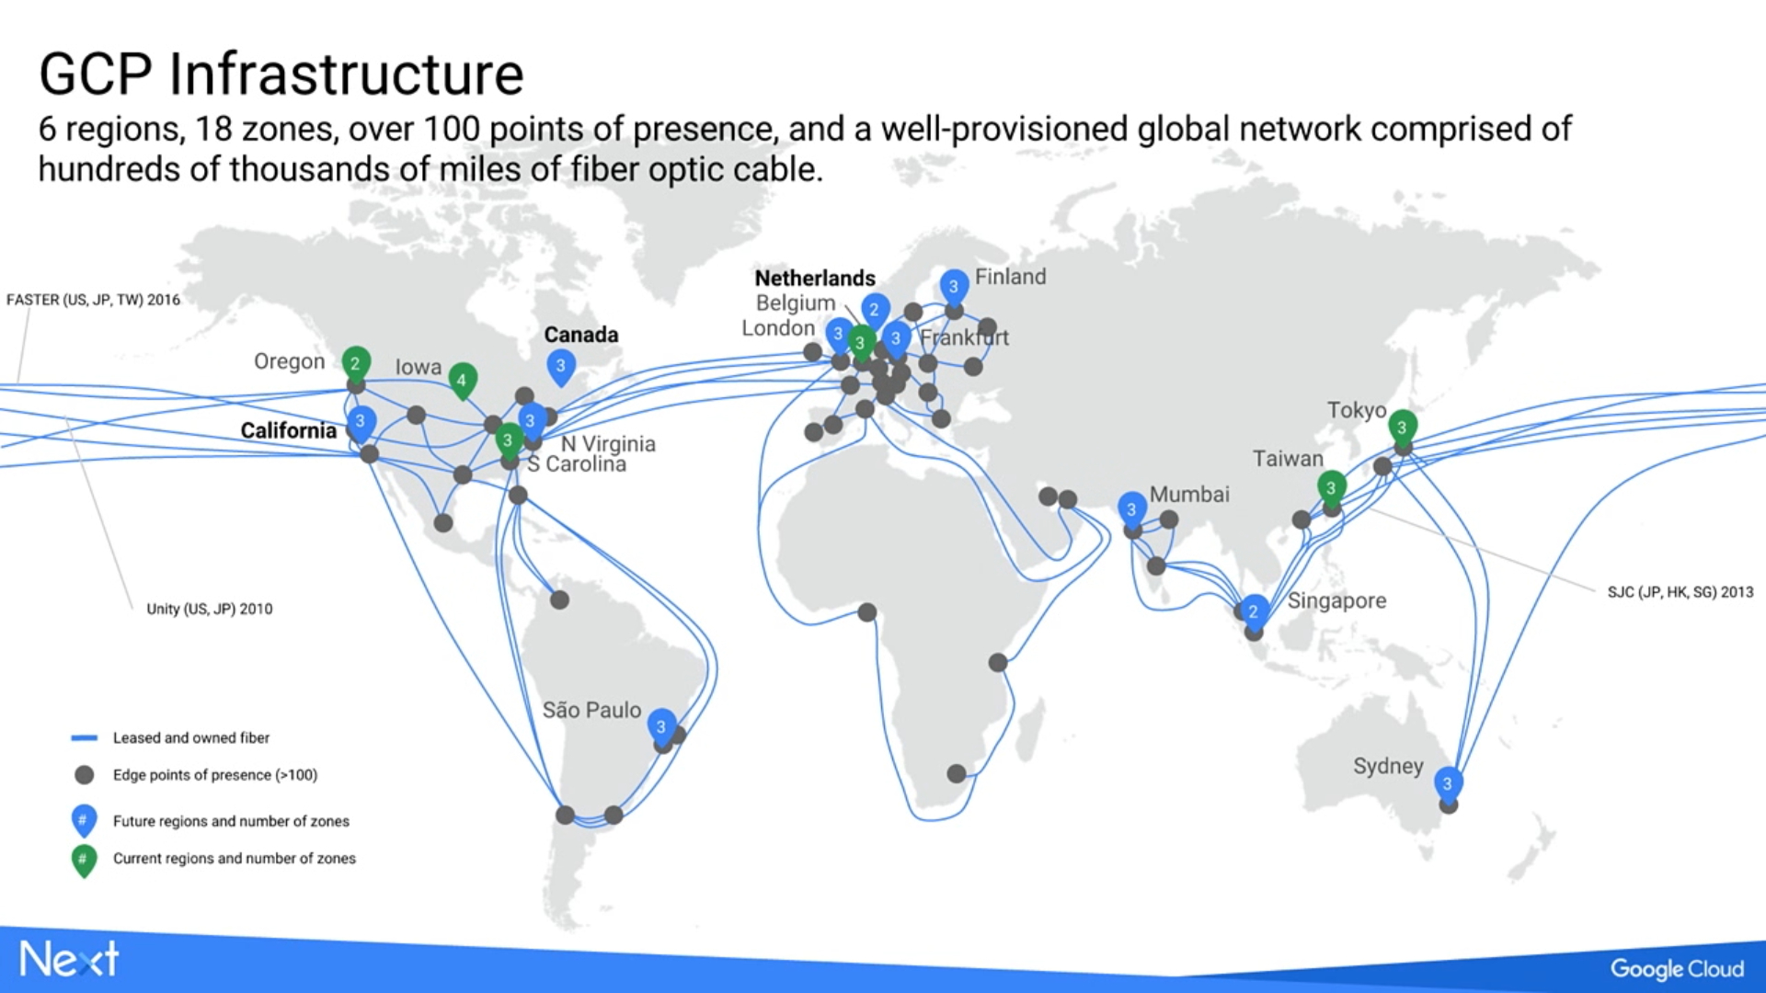

Slide 5
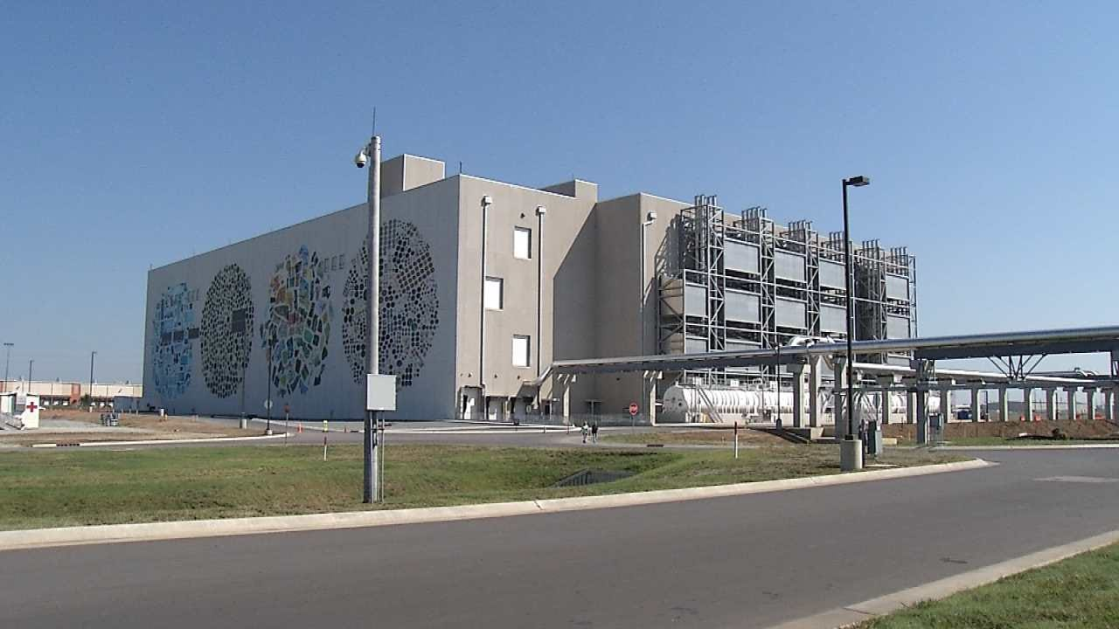

Slide 6
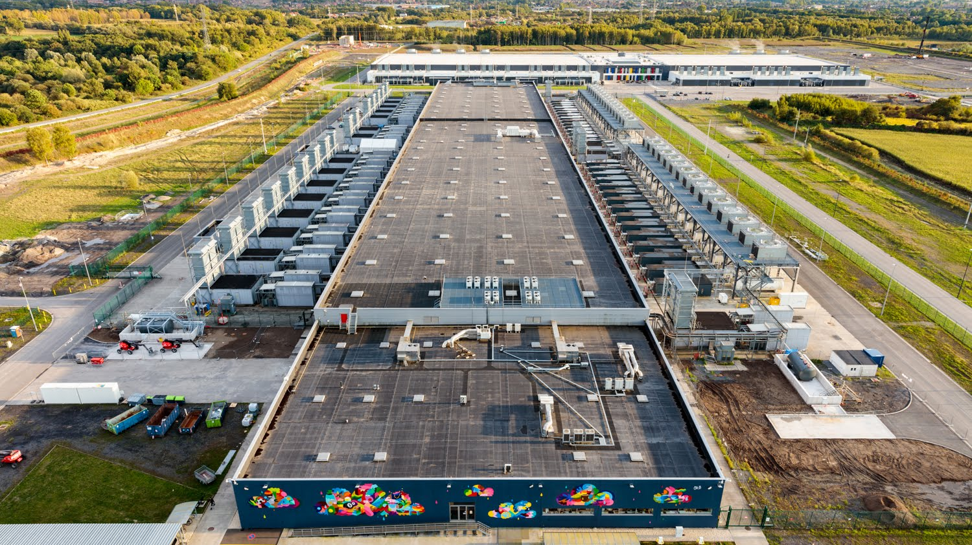

Slide 7
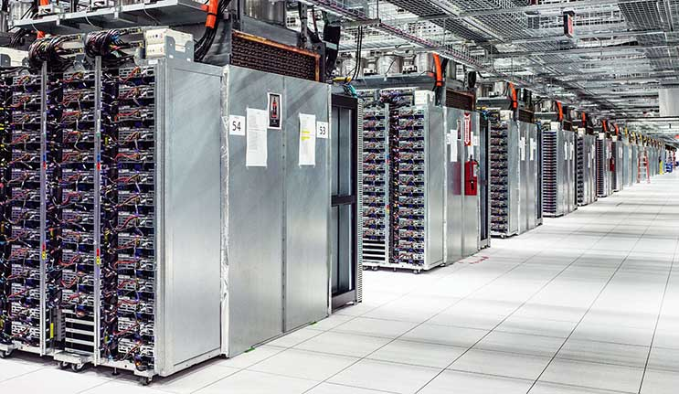

Slide 8


Slide 9


Slide 10
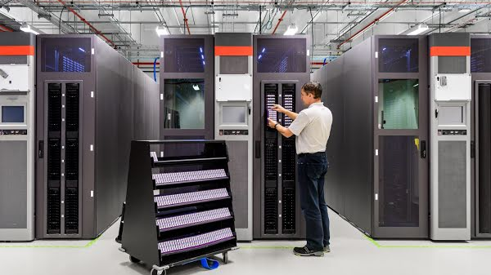

Slide 11


Slide 12
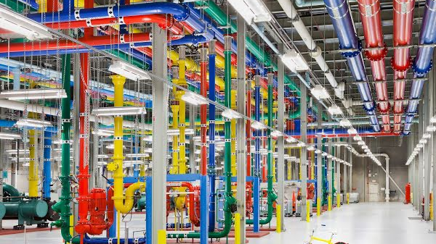

Slide 13


Slide 14


Slide 15


Slide 16


Slide 17
Architecture:
Cloud resources are harnessed to offer “computing / horsepower” required for providing services.
Often, this layer is implemented using a datacentre in which hundreds and thousands of nodes are stacked together.
The physical infrastructure is managed by the core middleware, to provide an appropriate runtime environment for applications and to best utilize resources.

Slide 18
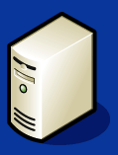






Cloud Applications
SaaS
User
Applications
Social Computing, Enterprise ISV, Scientific Computing, CDNs
Cloud Programming Environment and Tools
PaaS
Web 2.0, Mashups, Concurrent and Distributed Programming, Workflows , Libraries, Scripting
Pure PaaS
User-level
Middleware
IaaS
Cloud Hosting Platforms
QoS Negotiation, Admission Control, Pricing, SLA Management, Monitoring, Execution Management, Metering, Accounting
Adaptive Management
Autonomic Cloud Economy
IaaS (M)
Core
Middleware
Virtual Machine (VM), VM Management and Deployment
Cloud Resources
System
Infrastructure

Slide 19
Virtualization technologies are used to guarantee runtime environment customization, application isolation, sandboxing, and quality of service.
Partition the hardware resources such as CPU and memory and to virtualize specific devices, thus meeting the requirements of users and applications.
Uses Hardware virtualization
Hypervisors manage the pool of resources and expose the distributed infrastructure as a collection of virtual machine.
Storage and network virtualization strategies.
Specific service offered to end users, other virtualization techniques can be used.

Slide 20
Infrastructure management is the key function of core middleware, which supports capabilities such as negotiation of the quality of service, admission control, execution management and monitoring, accounting, and billing.
The combination of cloud hosting platforms and resources is generally classified as a Infrastructure-as-a-Service (IaaS) solution.
IaaS into two categories:
Some of them provide both the management layer and the physical infrastructure; others
provide only the management layer (IaaS (M)).
Users develop their applications specifically for the cloud by using the API exposed at the user-level middleware.
This approach is also known as Platform-as-a-Service (PaaS) -the service offered to the user is a development platform rather than an infrastructure..

Slide 21
Pure PaaS, only the user-level middleware is offered, and it has to be complemented with a virtual or physical infrastructure.
Top layer- SaaS-In most cases these are Web-based applications that rely on the cloud to provide service to end users.
The horsepower of the cloud provided by IaaS and PaaS solutions allows independent software vendors to deliver their application services over the Internet.
As a vision, any service offered in the cloud computing style should be able to adaptively change and expose an autonomic behaviour, in particular for its availability and performance.
Adaptive management layer in charge of elastically scaling on demand.
SaaS implementations should feature such behaviour automatically,
whereas PaaS and IaaS generally provide this functionality as a part of the API exposed to users.

Slide 22
The reference model introduces the concept of everything as a Service (XaaS).
Cloud services from different providers can be combined to provide a completely integrated solution covering all the computing stack of a system.
Virtual Web farms: a distributed system composed of Web servers, database servers, and load balancers on top of which pre-packaged software is installed to run Web applications.
Cloud computing an interesting option for reducing start-ups' capital investment in IT, allowing them to quickly commercialize their ideas and grow their infrastructure according to their revenues.

Slide 23
It is possible to distinguish three principal layers:
the physical infrastructure: the specific infrastructure used depends on the specific use of the cloud.
Provider: massive datacentre containing hundreds or thousands of nodes.
In house, in a small or medium-sized enterprise or within a university department, will most likely rely on a cluster.
consider a heterogeneous environment where different types of resources—PCs, workstations, and clusters—can be aggregated.
The software management infrastructure: - core features of an IaaS solution are implemented, management of the virtual machines is the most important function performed by this layer.
A central role is played by the scheduler, which is in charge of allocating the execution of virtual machine instances.
the user interface - access to the services exposed by the software management infrastructure.

Slide 24
Infrastructure- and hardware-as-a-service
Deliver customizable infrastructure on demand.
Hardware virtualization.
Priced according to the specific features of the virtual hardware: memory, number of processors, and disk storage.
Iaas/Haas solutions bring all the benefits of hardware virtualization: workload partitioning, application isolation, sandboxing, and hardware tuning.

Slide 25









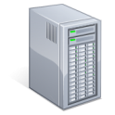

Web based Management Interface
Web Services, Portals, REST API
Infrastructure Management Software
Pricing / Billing
QoS SLA Management
Scheduling
Provisioning
Monitoring
Reservation
VM Image Repository
VM Pool Management
Physical Infrastructure
Datacenter
Cluster
Desktop /
Heterogeneous Resources
Third Party IaaS Cloud

Slide 26
The scheduler interacts with the other components that perform a variety of tasks:
Pricing and billing
Monitoring
Reservation
VM repository
VM Pool Manager
In the case of complete IaaS solutions, all three levels are offered as service-public clouds vendors such as Amazon, GoGrid, Joyent, Rightscale, Terremark, Rackspace, ElasticHosts, and Flexiscale, which own large datacenters.

Slide 27
Other solutions instead cover only the user interface and the infrastructure software management layers.
They need to provide credentials to access third-party IaaS providers or to own a private infrastructure in which the management software is installed.
This is the case with Enomaly, Elastra, Eucalyptus, OpenNebula, and specific IaaS (M) solutions from VMware, IBM, and Microsoft.
The role of infrastructure management software is not to keep track and manage the execution of virtual machines but to provide access to large infrastructures and implement storage virtualization solutions on top of the physical layer.

Slide 28
From the perspective of service provider, IaaS/HaaS allows better exploiting the IT infrastructure and provides a more secure environment where executing third party applications.
From the perspective of the customer, it reduces the administration and maintenance cost as well as the capital costs allocated to purchase hardware.
In most cases virtual machines come with only the selected operating system installed and the system can be configured with all the required packages and applications.
Other solutions provide pre-packaged system images that already contain the software stack required for the most common uses: Web servers, database servers, or LAMP1 stacks.
Additional services can be provided based on the SLA

Slide 29
Platform-as-a-Service (PaaS) solutions provide a development and deployment platform for running applications in the cloud.
They constitute the middleware on top of which applications are built.
The core middleware is in charge of managing the resources and scaling applications on demand or automatically, according to the commitments made with users.
Application management- core, applications with a runtime environment and do not expose any service for managing the underlying infrastructure.
They automate the process of deploying applications to the infrastructure, configuring application components,
provisioning and configuring load balancers and databases, and managing system change based on policies set by the user

Slide 30
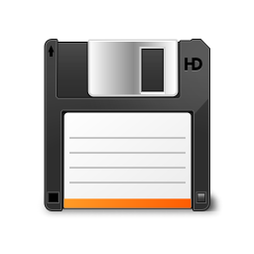

Web based Interface
Web Services, Portals, REST API
Programming API / Libraries
PaaS Core Middleware
Elasticity & Scaling
User
Management
Runtime
Application
Management
Resources Management
QoS / SLA Management &
Billing
Physical Infrastructure
IaaS Providers

Slide 31
It is possible to find integrated developed environments based on
4GL and visual programming concepts,
or rapid prototyping environments where applications are built by assembling mash-ups and user-defined components and successively customized.
PaaS solutions can offer
middleware for developing applications together with the infrastructure or
simply provide users with the software that is installed on the user premises
In the first case, the PaaS provider also owns large data centers where applications are executed;
In the second case, it is referred to as Pure PaaS

Slide 32
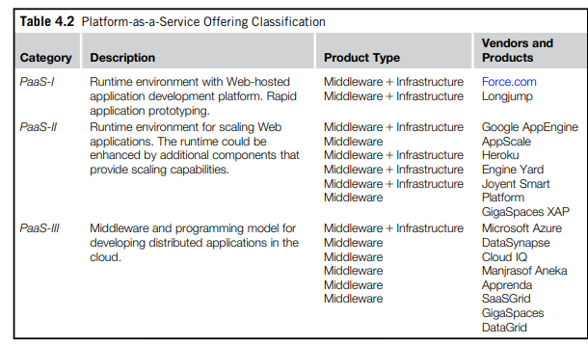

Slide 33
Essential characteristics that identify a PaaS solution:
• Runtime framework.
• Abstraction.
• Automation
• Cloud services

Slide 34
Software as a service
The acronym SaaS was then coined in 2001 by the software information & industry association (SIIA)
Software-as-a-service (SaaS) is a software delivery model that provides access to applications through the internet as a web-based service
Customers neither need install anything on their premises nor have to pay considerable up-front costs to purchase the software and the required licenses.
On the provider side,
The specific details and features of each customer’s application are maintained in the infrastructure and made available on demand.

Slide 35
SaaS as a “one-to-many” software delivery model, whereby an application is shared across multiple users.
Every enterprise will have the same requirements for the basic features concerning CRM and ERP; different needs can be satisfied with further customization
CRM is an acronym for Customer Relationship Management
ERP, an acronym for Enterprise Resource Planning,
SaaS applications are naturally multitenant. Multitenancy

Slide 36
On the customer side,
such costs constitute a minimal fraction of the usage fee paid for the software.
ASPs(Application Service Providers) already had some of the core characteristics of SaaS:
• The product sold to customer is application access.
• The application is centrally managed.
• The service delivered is one-to-many.
• The service delivered is an integrated solution delivered on the contract, which means provided as promised.

Slide 37
How is cloud computing related to SaaS?
SaaS approach lays on top.
It fits into the cloud computing vision expressed by the XaaS acronym,
Initially the SaaS model was of interest only for lead users and early adopters.
The benefits delivered at that stage were the following:
• Software cost reduction
• Service-level improvements
Rapid implementation
Standalone and configurable applications
Rudimentary application and data integration
Subscription and pay-as-you-go (PAYG) pricing

Slide 38
With the advent of cloud computing there has been an increasing acceptance of SaaS as a viable software delivery model
SalesForce.com is probably the most successful and popular example of a CRM service.
SalesForce.com builds on top of the Force.com platform, which provides a fully featured environment for building applications.
It offers either a programming language or a visual environment to arrange components together for building applications.
Another important class of popular SaaS applications comprises social networking applications such as Facebook and professional networking sites such as LinkedIn.

Slide 39
Developed as plug-ins for the hosting platform, as happens for Facebook, and made available to users, who can select which applications they want to add to their profile.
Office automation applications are also an important representative for SaaS applications: Google Documents and Zoho Office are examples
The role of SaaS solution enablers, which provide an environment in which to integrate third-party services and share information with others. A quite successful example is Box.net

Slide 40
Types of clouds
Public clouds. The cloud is open to the wider public.
Private clouds. The cloud is implemented within the private premises of an institution and generally made accessible to the members of the institution or a subset of them.
Hybrid or heterogeneous clouds. The cloud is a combination of the two previous solutions and most likely identifies a private cloud that has been augmented with resources or services hosted in a public cloud.
Community clouds. The cloud is characterized by a multi-administrative domain involving different deployment models (public, private, and hybrid), and it is specifically designed to address the needs of a specific industry.

Slide 41
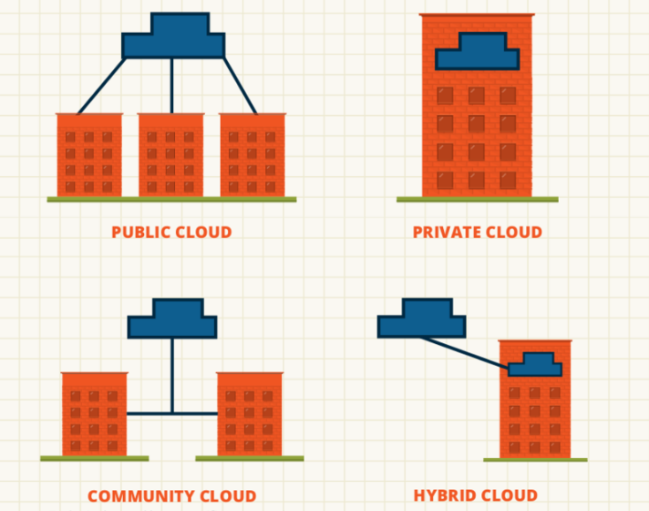

Slide 42
Public clouds
From a structural point of view they are a distributed system, most likely composed of one or more data centres connected together, on top of which the specific services offered by the cloud are implemented.
Historically, public clouds were the first class of cloud that were implemented and offered.
They have become an interesting option for small enterprises, which are able to start their businesses without large up-front investments by completely relying on public infrastructure for their IT needs.
By renting the infrastructure or subscribing to application services, customers were able to dynamically upsize or downsize their IT according to the demands of their business.

Slide 43
A fundamental characteristic of public clouds is multitenancy.
QoS management is a very important aspect of public clouds- bill
A public cloud can offer any kind of service: infrastructure, platform, or applications.
For example, Amazon EC2 is a public cloud that provides infrastructure as a service;
Google AppEngine is a public cloud that provides an application development platform as a service;
and SalesForce.com is a public cloud that provides software as a service.
From an architectural point of view there is no restriction concerning the type of distributed system implemented to support public clouds.
Amazon Web Services has data centers installed in the United States, Europe, Singapore, and Australia; they allow their customers to choose between three different regions: us-west-1, us-east-1, or eu-west-1.
Such regions are priced differently and are further divided into availability zones, which map to specific datacenters

Slide 44
Private clouds
Public clouds are appealing and provide a viable option to cut IT costs and reduce capital expenses, but they are not applicable in all scenarios.
Loss of control
Institutions such as government and military agencies will not consider public clouds as an option for processing or storing their sensitive data.
The risk of a breach in the security infrastructure of the provider could expose such information to others; this could simply be considered unacceptable.
USA patriot act
Private clouds are virtual distributed systems that rely on a private infrastructure and provide internal users with dynamic provisioning of computing resources

Slide 45
Instead of a pay-as-you-go model as in public clouds, there could be other schemes in place, considering the usage of the cloud and proportionally billing the different departments or sections of an enterprise
Advantage of keeping the core business operations in-house by relying on the existing IT infrastructure- data will not cross the existing infrastructure.

Slide 46
key advantages of using a private cloud computing infrastructure:
Customer information protection.
Infrastructure ensuring SLAs. - Quality of service
Compliance with standard procedures and operations
Architectural point of view, private clouds can be implemented on more heterogeneous hardware.
They generally rely on the existing IT infrastructure already deployed on the private premise ( datacenters/clusters/enterprise desktop grid/ combination of any)
The physical layer is complemented with infrastructure management software (i.e., IaaS (M);or a PaaS solution, according to the service delivered to the users of the cloud.
Private clouds can provide in-house solutions for cloud computing, but if compared to public clouds they exhibit more limited capability to scale elastically on demand.

Slide 47
Hybrid clouds
One of the major drawbacks of private deployments is the inability to scale on demand and to efficiently address peak loads.
A hybrid solution could be an interesting opportunity for taking advantage of the best of the private and public worlds.
It is a heterogeneous distributed system resulting from a private cloud that integrates additional services or resources from one or more public clouds.
For this reason they are also called heterogeneous clouds.

Slide 48
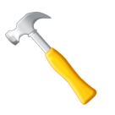







Hybrid / Heterogeneous Cloud
Private Cloud
Public Cloud
Paas
Dynamic
Provisioning
IaaS (M)
Public Cloud
Datacenter
Cluster
Desktop Grids /
NOWs

Slide 49
Dynamic provisioning is a fundamental component
Resources or services are temporarily leased for the time required and then released. This practice is also known as cloud bursting
Whereas the concept of hybrid cloud is general, it mostly applies to IT infrastructure rather than software services
Infrastructure management software and PaasS solutions are the building blocks for deploying and managing hybrid clouds.
Dynamic provisioning introduces a more complex scheduling algorithm and policies, the goal of which is also to optimize the budget spent to rent public resources
Dynamic provisioning is mostly implemented in PaaS solutions that support hybrid cloud

Slide 50
One of the fundamental components of PaaS middleware is the mapping of distributed applications onto the cloud infrastructure
In this scenario, the role of dynamic provisioning becomes fundamental to ensuring the execution of applications under the QoS agreed on with the user.
Each user application has a budget attached, and the scheduler uses that budget to optimize the execution of the application by renting virtual nodes if needed.

Slide 51
Community clouds
Community clouds are distributed systems created by integrating the services of different clouds to address the specific needs of an industry, a community, or a business sector.
The National Institute of Standards and Technologies (NIST) [43] characterizes community clouds as follows:
The infrastructure is shared by several organizations and supports a specific community that has shared concerns (e.g., mission, security requirements, policy, and compliance considerations). It may be managed by the organizations or a third party and may exist on premise or off premise.

Slide 52





Community Cloud
Infrastructure
Application
Services
3rd Party Cloud
Public Cloud
Development
Platforms
Private Cloud
Public Cloud
Private Cloud
Federal and
Government Bodies
Private
Users
Industries
Enterprises
Public Services

Slide 53
The users of a specific community cloud fall into a well-identified community, sharing the same concerns or needs; they can be government bodies, industries, or even simple users, but all of them focus on the same issues for their interaction with the cloud.
From an architectural point of view, a community cloud is most likely implemented over multiple administrative domains.
Candidate sectors for community clouds are as follows:
Media industry.
Healthcare industry.
Energy and other core industries.
Public sector.
Scientific research.

Slide 54
Benefits of these community clouds are the following:
Openness.
Community.
Graceful failures.
Convenience and control.
Environmental sustainability.

Slide 55
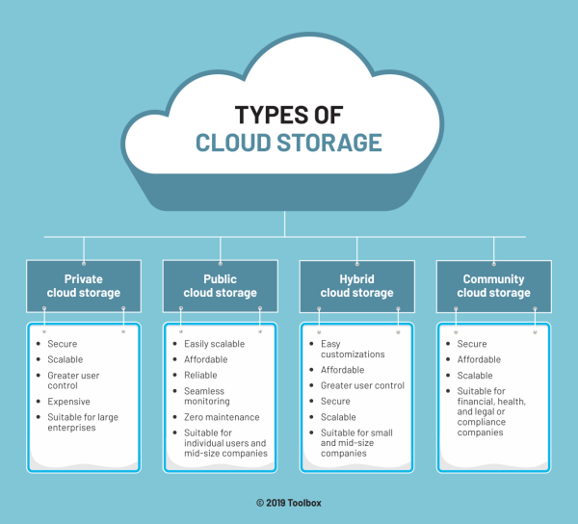

Slide 56
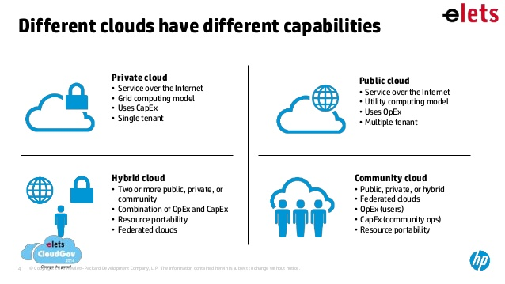

Slide 57
Economics of the cloud
Biggest benefit of this phenomenon is financial: the pay-as-you-go model offered by cloud provider.
Capital costs are one-time expenses that are generally paid up front and that will contribute over the long term to generate profit.
Cloud computing allows:
Reducing the capital costs associated to the IT infrastructure
Eliminating the depreciation or lifetime costs associated with IT capital assets
Replacing software licensing with subscriptions
Cutting the maintenance and administrative costs of IT resource

Slide 58
In the case of a small startup, it is possible to completely leverage the cloud for many aspects, such as:
IT infrastructure
Software development
CRM and ERP
In terms of the pricing models introduced by cloud computing, we can distinguish three different strategies that are adopted by the providers:
Tiered pricing :This model is used by Amazon for pricing the EC2 service
Per-unit pricing: Example, by GoGrid, which makes customers pay according to RAM/hour units for the servers deployed in the GoGrid cloud
Subscription-based pricing- SaaS- periodic usage

Slide 59
Open challenges
The definition and the formalization of cloud computing,
Cloud interoperability and standards
Scalability and fault tolerance
Security, trust and privacy
and organizational aspects.

Slide 60
Definition and the formalization of cloud computing,
Several attempts made to define cloud computing
Comprehensive formalizations is noted in the NIST working definition of cloud computing:
It characterizes cloud computing as on-demand self-service, broad network access, resource-pooling, rapid elasticity, and measured service; classifies services as SaaS, PaaS, and IaaS; and categorizes deployment models as public, private, community, and hybrid clouds.
A different approach has been taken at the University of California:
The concept of a cloud is dissected into five main layers: applications, software environments, software infrastructure, software kernel, and hardware. Each layer addresses the needs of a different class of users within the cloud computing community and most likely builds on the underlying layers.

Slide 61
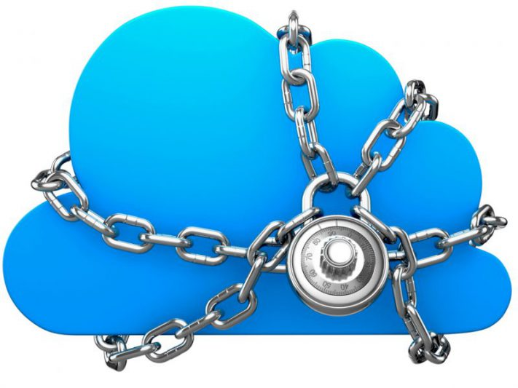
Cloud interoperability and standards
To fully realize the goal of CC, introducing standards and allowing interoperability between solutions offered by different vendors are objectives of fundamental importance.
Vendor lock-in, also known as proprietary lock-in or customer lock-in, makes a customer dependent on a vendor for products and services, unable to use another vendor without substantial switching costs.
The presence of standards that are actually
implemented and adopted in the cloud computing
community could give room for interoperability and
then lessen the risks resulting from vendor lock-in.

Slide 62
Another direction in which standards try to move is devising a general reference architecture for cloud computing systems and providing a standard interface through which one can interact with them.
Amazon Web Services plays a leading role, and other IaaS solutions, mostly open source, provide AWS-compatible APIs, thus constituting themselves as valid alternatives.
Scalability and fault tolerance:
The challenge in this case is designing highly scalable and fault-tolerant systems that are easy to manage and at the same time provide competitive performance.
The costs are a reality for whomever develops, manages, and maintains the cloud middleware and offers the service to customers.
In this scenario, the ability to tolerate failure becomes fundamental, sometimes even more important than providing an extremely efficient and optimized system

Slide 63
Security, trust, and privacy
Security, trust, and privacy issues are major obstacles for massive adoption of cloud computing.
The traditional cryptographic technologies are used to prevent data tampering and access to sensitive information.
The massive use of virtualization technologies exposes the existing system to new threats, which previously were not considered applicable.
The lack of control over their own data and processes also poses severe problems for the trust we give to the cloud service provider and the level of privacy we want to have for our data.
when a violation of privacy or illegal access to sensitive information is detected, it could become difficult to identify who is liable for such violations.
The challenges in this area are, then, mostly concerned with devising secure and trustable systems from different perspectives: technical, social, and legal

Slide 64
Organizational aspects
From an organizational point of view:
Major advantages of moving IT infrastructure and services to the cloud is to reduce or completely remove the costs related to maintenance and support.
As a result, users of such infrastructure and services lose a reference to deal with for IT troubleshooting.
At the same time, the existing IT staff is required to have a different kind of competency and, in general, fewer skills, thus reducing their value.
These are the challenges from an organizational point of view that must be faced and that will significantly change the relationships within the enterprise itself among the various groups of people working together.

Slide 65
Assignment
Research popular cloud storage providers. Categorize them based on their deployments. Compare prices and plans available.
Visit URL- https://www.intel.in/content/www/in/en/cloud-computing/cloud-101-video.html ( Difference between Clouds)

